Slide 1

How Effective are Large Language Models for Sports Betting?
By Konnor Boucher
5/8/25

Slide 2
Some Background
What is AI and Large Language Models?
What is a Money Line Bet?
Basics of Sports Betting

Slide 3
How are Payouts Calculated?
Odds can be positive or Negative
Positive = Bet Amount * (Odds / 100)
Negative = Bet Amount / (Odds / -100)
Positive Odds = Underdog won
Negative Odds = Favorite won

Slide 4
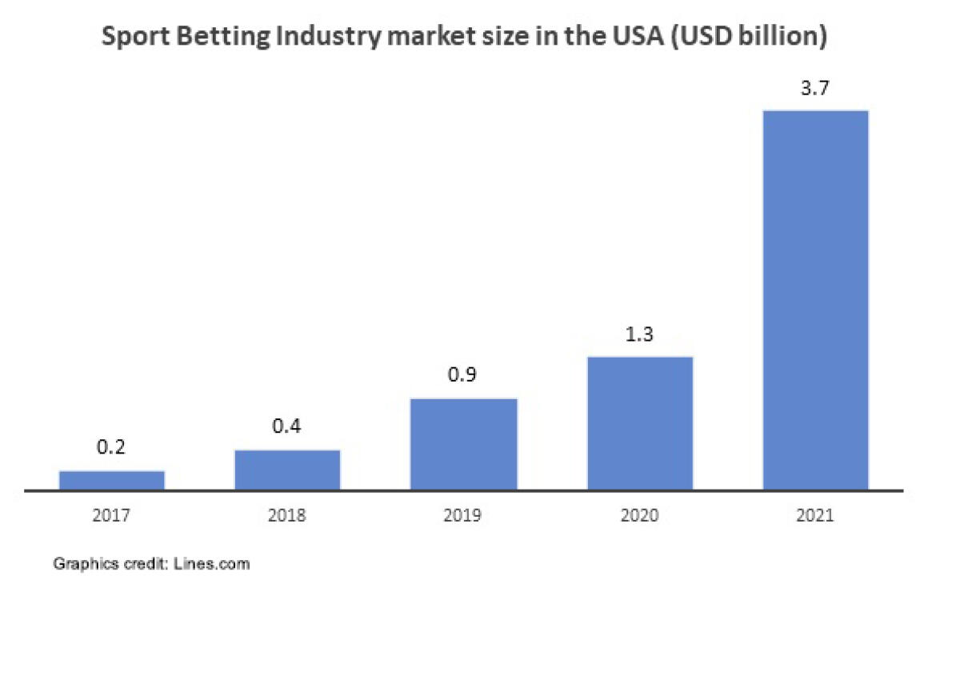
Why is this Important?
Sports Betting has become a billion-dollar industry
Impact of COVID
Recent Development = Best Opportunity
How to start?
https://www.lines.com/upload/default/xl/UqX/UqXXkycOPNXT.jpg

Slide 5





Objective: Determine which of Three Large Language models is most effective for NBA Money Line Betting

Slide 6
Project Details
3 LLMs used
Meta, Gemini and Copilot (latest versions as of April 1st, 2025)
Each LLM had 3 Inputs Types
No data, Data, Upset
Input was the same, and recorded in a doc
Data was kept in an Excel sheet
Both can be accessed here: https://github.com/KonnorBoucher/Senior_Research_Project
DraftKings used as bookkeeper for odds, Odds Here: (https://sportsbook.draftkings.com/leagues/basketball/nba?wpcid=605461783&wpsnetn=o&wpkwn=draftkings%20nba%20odds&wpkmatch=e&wpcrid=&wpscid=1334809637221892&wpkwid=kwd-83426762688010:loc-4086&an=adwords&gclid=68ce10cc11ab18c6e1d778d03564d457&gclsrc=3p.ds&msclkid=68ce10cc11ab18c6e1d778d03564d457&utm_source=bing&utm_medium=cpc&utm_campaign=SB_NAT_Brand%2B_Sports&utm_term=draftkings%20nba%20odds&utm_content=Brand%2B_All%20Devices_Basketball)
115 Total games, 15 days
Assumed bet for each = $5

Slide 7
Helper Python Program
Did the following:
Used pandas to manipulate .csv file
Calculated profits
Averaged out values
Created 6 unique figures, (4 shown)

Slide 8
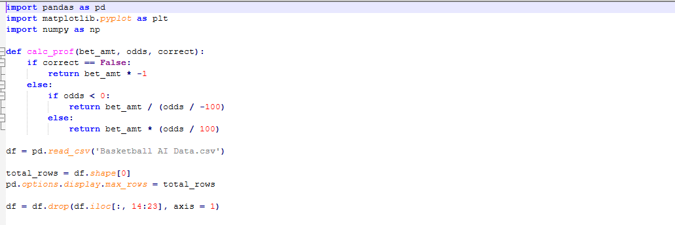
Example Part of Program

Slide 9
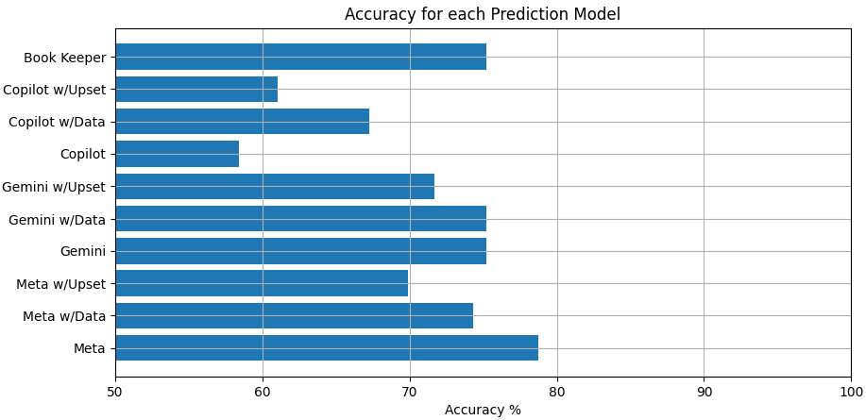
Accuracy for each Prediction Model

Slide 10
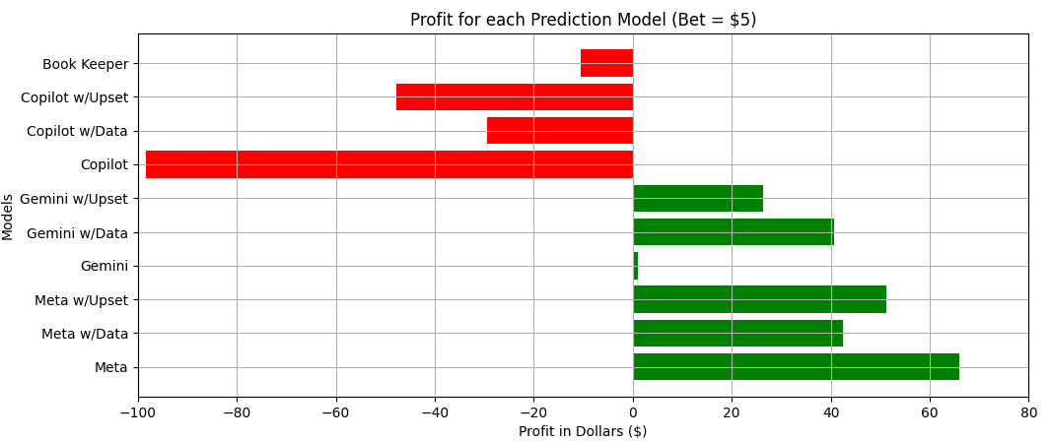
Profit for each Prediction Model

Slide 11
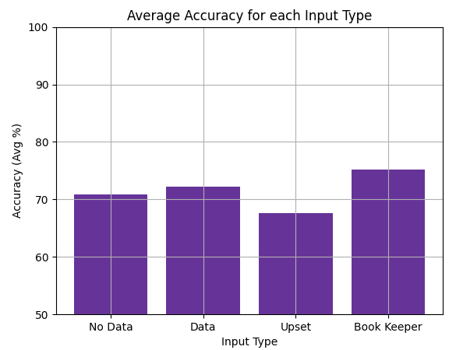
Average Accuracy per Input Type

Slide 12
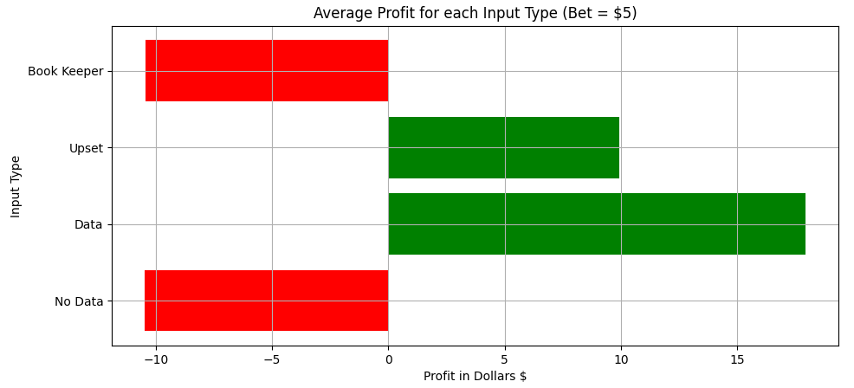
Average Profit per Input Type

Slide 13
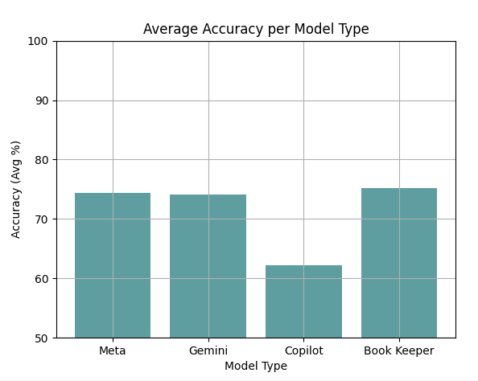
Average Accuracy per Model

Slide 14
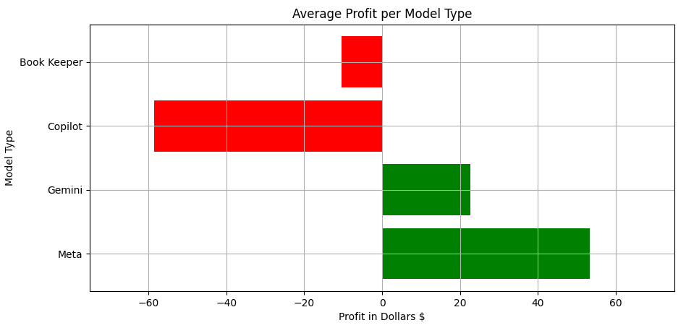
Average Profit Per Model

Slide 15
Conclusions
What was the best model?
Any trends?
What can be learned?

Slide 16

Limitations / Further Study
Amount of games
Only NBA Moneyline
Only 15-day span

